Slide 1

JTest
By: FA Team
Course duration: 4 hours
Last update: Jan 2008

Slide 2

Content
Introduction
Explore Jtest
Jtest static analysis
Jtest White-Box Testing
Jtest Black-Box Testing
Jtest Regression Testing
Others
Confidential
Page ‹#›

Slide 3
Content by Staff Level
For 1-year engineer (junior engineer)
Introduction
Explore Jtest
Jtest static analysis
Jtest White-Box Testing
Jtest Black-Box Testing
Jtest Regression Testing
Others
Confidential
Page ‹#›

Slide 4
Section #1
Introduction
What is Jtest?
Abbreviate
What can Jtest support us?
Testing Categories
Static Analysis
White-Box Testing
Black-Box Testing
Regression Testing
Iteration
Confidential
Page ‹#›

Slide 5

What is Jtest?
Jtest is an automated Java testing and coding standard analysis product that is made by Parasoft. It aims to improve Java code reliability, functionality, security, performance, and maintainability. Basic functionality includes Unit test-case generation, static analysis, regression testing, and code review.
Confidential
Page ‹#›

Slide 6
Abbreviate
AEP: Automated Error Prevention
DbC: Design by Contract
JTest: JTest 8.0
TC: Test Case
Confidential
Page ‹#›

Slide 7
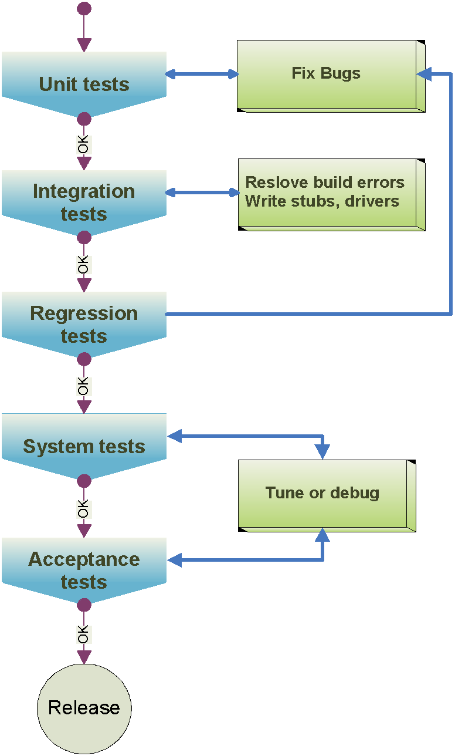
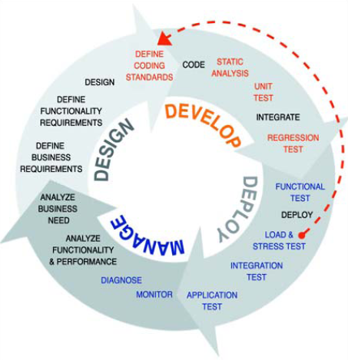

What can Jtest support us?
67%
7%
25%
1%
Confidential
Page ‹#›

Slide 8
Testing Categories
There are few tests which can be performed in order to significantly reduce the number of errors in our code:
Static Analysis
White-Box Testing
Black-Box Testing
Regression Testing
Confidential
Page ‹#›

Slide 9
Static Analysis
Static code analysis is the analysis of computer software that is performed without actually executing programs built from that software
Parasoft’s static analysis technologies support
Flow-based static analysis (BugDetective)
Data flow static analysis statically simulates application execution paths, which may cross multiple units, components, and files. It’s like testing without actually executing the code. It can automatically detect potential runtime errors such as resource leaks, NullPointerExceptions, SQL injections, and other security vulnerabilities.
Pattern-based static analysis
Scan the code and check whether it has patterns known to cause defects or impede reuse and agility. This involves monitoring compliance to coding standard rules—rules for preventing improper language usage, satisfying industry standards (MISRA, JSF, Ellemtel, etc.), and enforcing internal coding guidelines.
Confidential
Page ‹#›

Slide 10
White-Box Testing
White-box testing doesn't test that the class behaves according to the specification, but instead, it ensures that the class doesn't crash and that it behaves correctly when passed unexpected input.
White-box involves looking at the class code and trying to find out if there are any possible class usages that will make the class crash (in Java this is equivalent to throwing an uncaught runtime exception).
White-box testing is a process that checks code using test data derived from the class's internal structure.
Confidential
Page ‹#›

Slide 11
Black-Box Testing
Black-box testing checks that the class behaves according to the specification, meaning that the class produces the correct output for each input.
The tester does not know anything about how the program is coded. He simply takes any output, and compares it to what he thinks is the desired output.
We can view the program as a "black-box", whose behavior can be determined by studying its inputs and the related outputs.
Confidential
Page ‹#›

Slide 12
Regression Testing
Regression testing checks that the class behavior doesn't break when the code is modified.
Regression testing checks that the class continues to perform correctly after it has been modified.
In regression we’re going back over our previous tests to ensure that the bug we previously found has been fixed and that no new bugs have been introduced.
Confidential
Page ‹#›

Slide 13






Iteration
Design by Contract
1
Design by Contract (DbC) is a formalism that allows the programmer to annotate code with “contracts”(pre– and post– conditions) by using Javadoc comments.
Jtest automates black-box testing for classes or components which contain DbC contracts.
The benefits of using DbC
Automatically create black-box test cases.
Automatically update black-box test cases.
Automatically detect misuse class/component.
Can assume that input arguments satisfy the preconditions.
Guarantee the results will satisfy the post conditions.
Adding DbC comments
2
auto-generate
run
Auto-generate
unit tests
Auto-generate unit test
Perform unit test
Automatically generate JUnitformat test cases
White Box test cases are auto-generated.
Black-box test cases are automatically created base on DbC comments.
Check coding standards
Executes the generated test case
Checking DbC comments
Performing regression testing
Calculating real coverage
Detect memory leaks (optional)
Assigns any errors to the appropriate user
Generate HTML/XML reports
Customizable
3
Jtest Quick Fix
Perform unit tests
Define/Customize the coding conversion rules
Perform Black Box Test with “Design by Contract” feature
Extend these automatically-generated test cases to
Increase test coverage.
Verify unit-level functionality.
Verify sub-module, module, and system-level functionality
customize
Quick fixing coding standard errors (200+ rules)
Suppressing and un-suppressing reported errors
Provide Error found View and Test Class Outline View to help you identify errors and debugs
4
Fix bugs and coding conversion violation
5
Adding custom test
Confidential
Page ‹#›

Slide 14
Section #2
Explore Jtest
Generate and Run Jtest
Play button
Test Case Outline View
View coding standard violation
View Unit Test Errors
Coverage View
Confidential
Page ‹#›

Slide 15


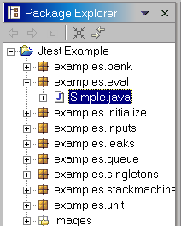




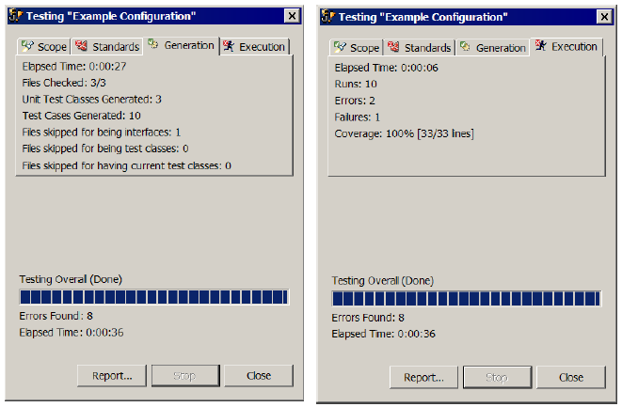



Generate and Run Jtest
2
2
1
Select the classes or packages to test in the Package Explorer View
Choose File> New> Jtest Example Project
4
4
After finishing auto-generate and test the classes
Jtest display a summarization of the progress testing result
3
3
Click the Play button in the toolbar
Confidential
Page ‹#›

Slide 16
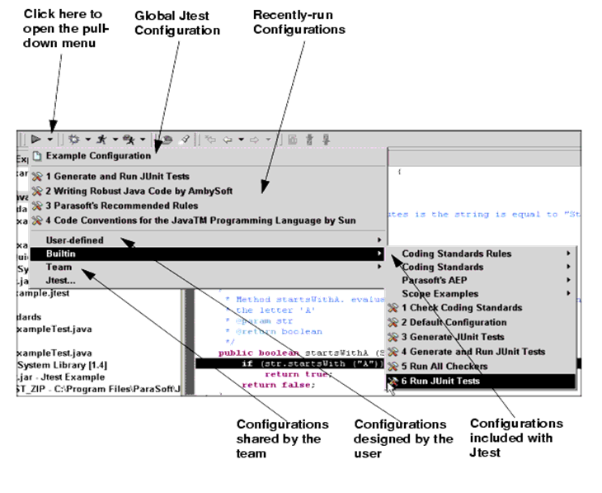
Play button
Confidential
Page ‹#›

Slide 17
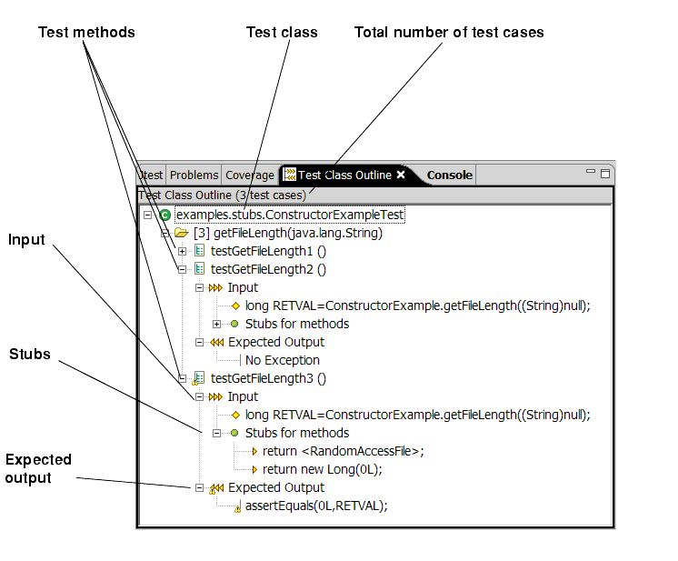
Test Case Outline View
Confidential
Page ‹#›

Slide 18
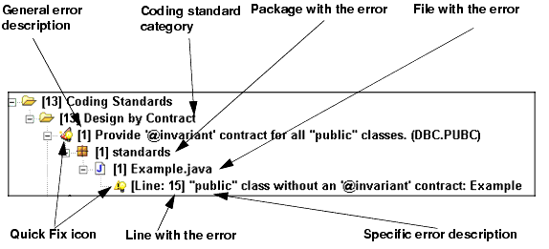
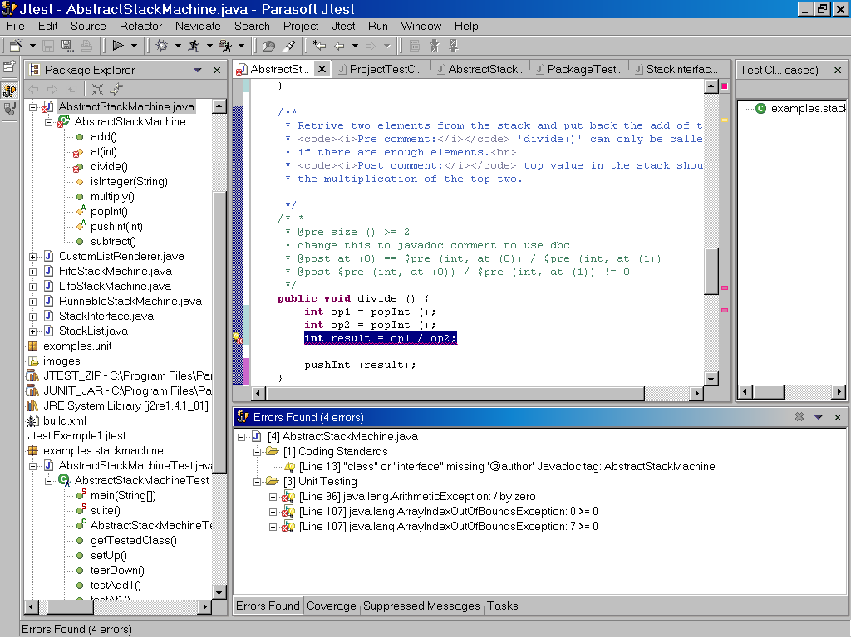

View coding standard violation
Error Found View
Confidential
Page ‹#›

Slide 19
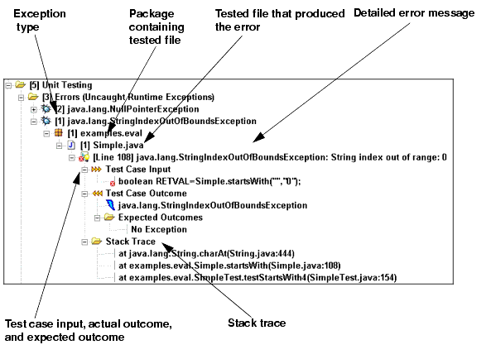
View Unit Test Errors
Unit Test Error
Confidential
Page ‹#›

Slide 20
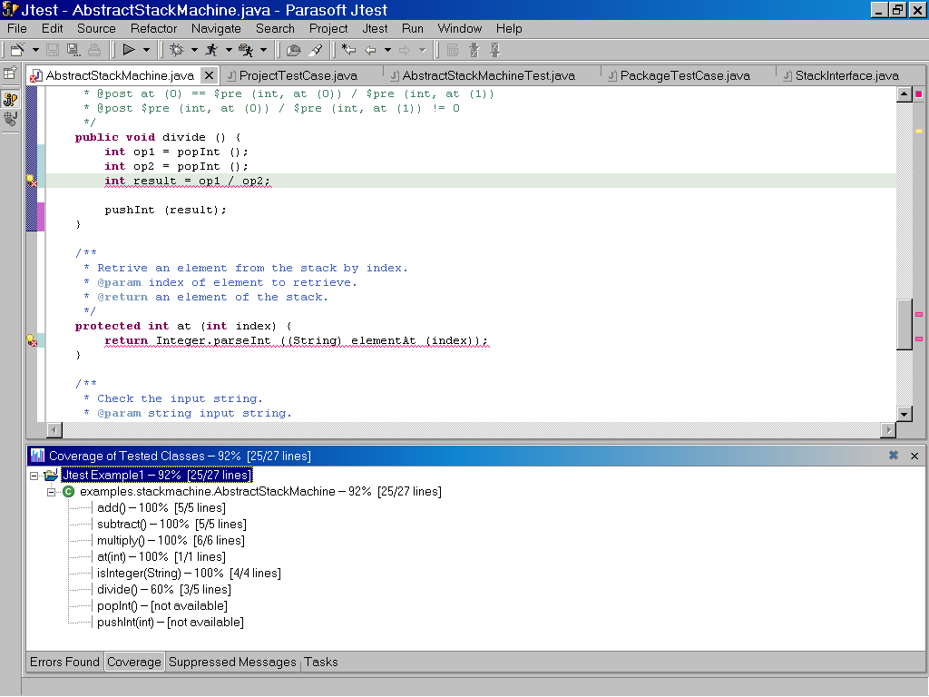









Coverage View
Confidential
Page ‹#›

Slide 21
Section #3
JTest static analysis
Overview
Coding standard
Example
The standard tab
Error found window
Automatic fixing
Confidential
Page ‹#›

Slide 22
Overview
Static analysis can be thought of as consisting of both an automatic code review and automatic coding standards enforcement.
Adhering to coding standards is an effective error prevention strategy. Coding standards are rules that ensure that code is written in a way that makes it less error-prone.
By adhering to these standards, we significantly reduce the opportunities to introduce errors in the code.
Adhering to coding standards enforcement also makes code more readable and easier to maintain.
Jtest statically analyzes each class by parsing its Java source code and comparing it to a set of coding rules.
Jtest can automatically correct many of the coding standard errors it identifies.
Confidential
Page ‹#›

Slide 23
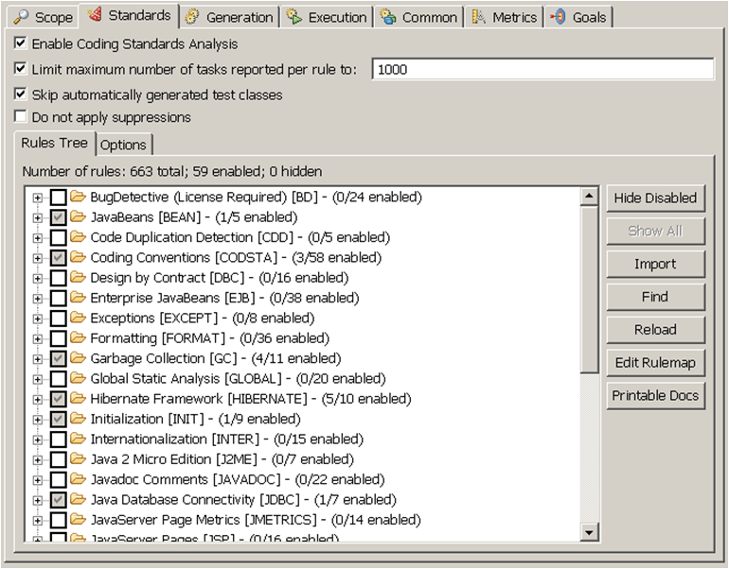
Coding standards
Context menu to view rule documentation
Confidential
Page ‹#›

Slide 24
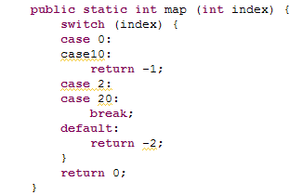
Example
To check whether a class follows the default set of Jtest coding standards:
Select the class resource, and click the Play button in the toolbar.
By default, when you click this button, Jtest will check coding standards as well as perform unit testing.
Confidential
Page ‹#›

Slide 25
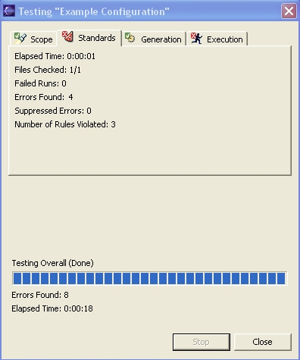
The standard tab
A Jtest summary panel opens after the test completes. The Standards tab of this panel displays the following information about the coding standard test run:
Elapsed time for the coding standards checking.
Number of files checked.
Number of failed runs.
Number of errors found.
Number of suppressed errors.
Number of rules violated.
Confidential
Page ‹#›

Slide 26
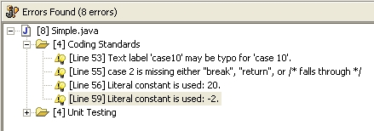
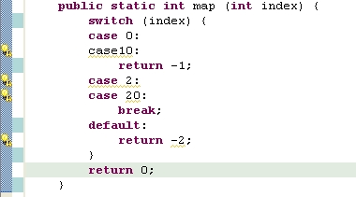
Errors found window
Text label ‘case10’ maybe typo for ‘case 10’
The Rule: Avoid using text labels in "switch" statements.
case 2 is missing either “break”, return, or
/* falls through */
The Rule: Avoid a "switch" statement with a bad "case".
Literal constant is used: 20
The Rule: Avoid using literal constants.
Exceptional constants: -1, 0, 1, 2, 3, 4, 5, 6, 7, 8, 9, 10, 0.0, 0L, 0.0F, 0.0D, 0xF, 0xD
Literal constant is used: -2
The Rule: Avoid using literal constants.
Exceptional constants: -1, 0, 1, 2, 3, 4, 5, 6, 7, 8, 9, 10, 0.0, 0L, 0.0F, 0.0D, 0xF, 0xD
Confidential
Page ‹#›

Slide 27
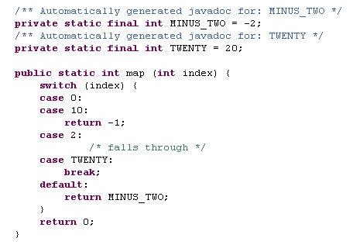
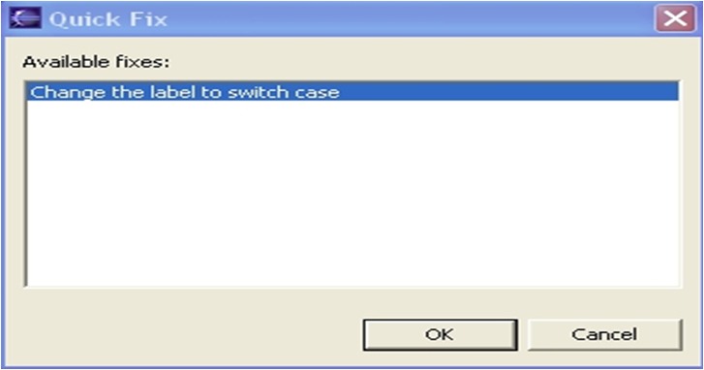
Automatic fixing of coding standard errors
Jtest can automatically correct many of the coding standard errors it identifies.
Confidential
Page ‹#›

Slide 28
Section #4
Jtest White-Box Testing
Overview
Example
Error found window
Few Words on Design by Contracts…
Automatic fixing
After the fixing
Confidential
Page ‹#›

Slide 29
Overview
White-box involves looking at the class code and trying to find out if there are any possible class usages that will make the class throwing an uncaught runtime exception.
Jtest executes the class under test using a symbolic virtual machine.
While executing each bytecode, it checks if there are solutions to the equations that will make the bytecode throw an uncaught runtime exception. If it finds a solution it reports an error for it.
Confidential
Page ‹#›

Slide 30
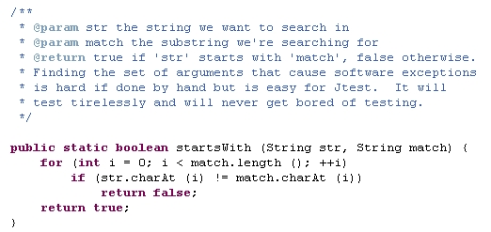
Example
Confidential
Page ‹#›

Slide 31
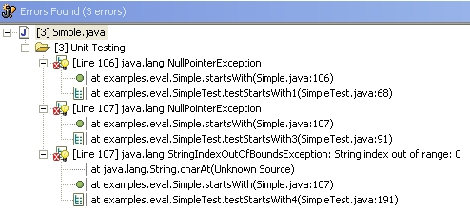

Error found window
/* NullPointerException */
public void testStartsWith1() throws Throwable {
boolean RETVAL = Simple.startsWith(null, null);
}
/* StringIndexOutOfBoundsException */
public void testStartsWith4() throws Throwable {
boolean RETVAL = Simple.startsWith(“”, “0”);
}
/* NullPointerException */
public void testStartsWith3() throws Throwable {
boolean RETVAL = Simple.startsWith(null, “0”);
}
Confidential
Page ‹#›

Slide 32
Few Words on Design by Contracts…
In order to fix white box testing errors, Jtest uses the principle of DBC.
A program is correct if it performs according to its specification.
The principal idea of DBC is that a class and its clients have a contract with each other: The client must guarantee certain conditions before calling a method specialized on the class (the preconditions), the class guarantees certain properties after the call (the post-conditions).
If the pre- and post conditions are included in a form that the compiler can check, then any violation of the contract between caller and class can be detected immediately.
Confidential
Page ‹#›

Slide 33
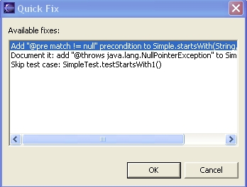
Automatic fixing white-box testing
Jtest can automatically correct many of the white box testing it identifies.
Confidential
Page ‹#›

Slide 34
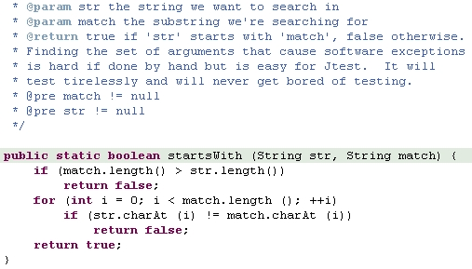
After the fixing
Confidential
Page ‹#›

Slide 35
Section #5
Jtest Black-Box Testing
Overview
Example
Error found window
Create user-defined test case
Confidential
Page ‹#›

Slide 36
Overview
Black-box testing checks that the class produces the correct output for each input.
In general, any black-box testing tool requires the user to specify a set of inputs to try, along with the correct outputs for those inputs. The tool then runs the inputs automatically and checks that the correct outputs are generated.
Jtest automatically generates a set of sophisticated inputs; Jtest analyzes the class bytecodes and provides a minimal set of inputs that produce as much coverage as possible for the class.
Jtest executes all of the inputs and provides the actual outcomes for those inputs.
The developer can see the outcomes and verify them with one click of a button.
when Jtest performs subsequent tests on this class, it will notify us if a different outcome is produced.
Confidential
Page ‹#›

Slide 37
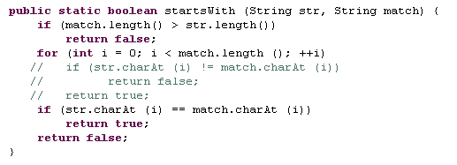
Example
Confidential
Page ‹#›

Slide 38
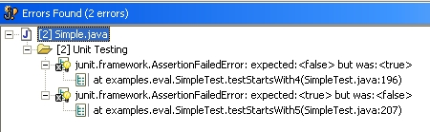
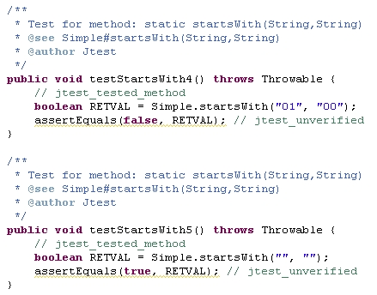
Errors found window
Expected: <false> but was: <true>
Expected: <true> but was: <false>
Confidential
Page ‹#›

Slide 39
Create user-defined test case
Let’s assume that we want to add our own test case to the method map, and to check what’s happening when we execute it with ’34’ as input.
All we need to do is to add to class SimpleTest.java the following method:
public void testMap() { assertTrue(Simple.map(34) == -2); }
And run the unit test again.
Confidential
Page ‹#›

Slide 40
Section #5
Jtest Regression Testing
Overview
Example
The error
Automatic fixing
Confidential
Page ‹#›

Slide 41
Overview
When Jtest first runs a unit test, it takes a "snapshot of the current functionality of each method tested, and records its behavior in a JUnit-format test case.
Jtest provides automatic regression testing. Even if we don't specify what the correct outcomes are, Jtest remembers the outcomes from previous runs and compares them every time the class is tested and reports an error for any outcome that changes.
Confidential
Page ‹#›

Slide 42

Example
Let’s assume that we’re changing the add method to reduce i2 from i1, it can be intentional, but it can also be a typo.
Confidential
Page ‹#›

Slide 43

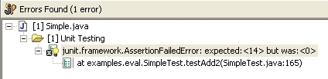
The error
Since we have the test case:
We will get the following error:
Confidential
Page ‹#›

Slide 44
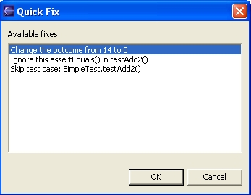

Automatic fixing
Confidential
Page ‹#›

Slide 45
Section #6
Others
Jtest command line
jtestcli with ant
Tips
Conclusion
QnA
Confidential
Page ‹#›

Slide 46
Jtest command line interface (jtestcli)
Command: jtestcli (%JT_HOME%/jtestcli.exe)
Options:
-data | Specifies workspace location.
-config | Specifies test configuration.
-resource | Specifies project(s)/file(s) to be tested.
-report | Specifies directory for HTML report location.
-help | Displays help information.
Confidential
Page ‹#›

Slide 47
Run Jtest from Command line
Typically, invocations follow this pattern:
Windows: jtestcli.exe -data %WORKSPACE_DIR% -resource %RESOURCE% -report %REPORT_FILE%
UNIX: jtestcli -data %WORKSPACE_DIR% -resource %RESOURCE% -report %REPORT_FILE%
Example: jtestcli.exe -data "c:\program files\parasoft\jtest5.0\workspace" -resource "Jtest Example" -report c:\reports\Report
Confidential
Page ‹#›

Slide 48
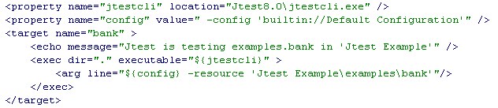
jtestcli with ant
jtestant.jar library must be on the classpath
Specific workspace
Execute jtestcli
Specific package
Specific configuration
Confidential
Page ‹#›

Slide 49

Tips
Preventing Jtest from running out of memory
Start Eclipse with: eclipse -vmargs -XX:MaxPermSize=256m
Confidential
Page ‹#›

Slide 50




Conclusion - JTest Supports
Checking coding standards.
Generating, executing JUnit format unit tests (White Box).
Report coding conversion violation, errors.
Monitors test coverage.
Automatically fixing coding standard errors.
Detect memory leak.
Performs automated regression testing.
Automatically
Define/Customize the coding conversion rules
Extend JUnit format unit tests.
Provides a fast and easy way to add black-box tests, module tests, and system tests the abilities to write stub, driver, test suit, customize tests).
Perform Black Box Test with Design by Contract feature.
Perform sub-module, module, and system testing by extending the unit-level functional test cases, then running the extended test suite.
Customization
Confidential
Page ‹#›

Slide 51

Question and Answer
Confidential
Page ‹#›

Slide 52
Exercise / Questionnaire

Slide 53
Appendix: Course detail form
Author | FA team | Duration | 4 Hours
Category | Software Engineering | Type | Theory / Theory and Practice
Examination | Review questions / quiz will be at the end of the course. The purpose is to review the awareness of all attendees on some important points of this course
Intended Audience | Any software technician, engineer, project leader, project manager, manager who are working in software related projects.
Pre-requisites | Those who have basic knowledge of programming language and unit testing
Completion criteria for the course | Attendee must join at least 80% of course length and finish the review questions section with score rate of 75% or higher.
Criteria for granting training waivers | Those who has experience on JTest, or already attended similar courses
Confidential
Page ‹#›

